Slide 1
SoC 2024
Network Intrusion Detection Model
By: Ank Kumar Gupta

Slide 2
Problem Statement
Building a Network Intrusion Detection System (NIDS) Framework:
Developing an automated anomaly detection system.
Should be able to monitor network traffic for suspicious activity.
Should include feature of anomaly detection.
Should be able to detect potential anomalies for test data.

Slide 3
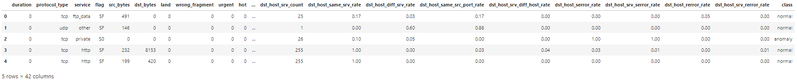
Proposed Solution
Found a training dataset classifying network traffic in anomaly and normal on kaggle. Link: Kaggle Network Intrusion Detection Dataset
The training dataset consists of 42 features and 25192 data points.

Slide 4
Proposed Solution
Preprocessed the data to make it suitable for training the ML models.
It involved checking for missing data points, duplicated rows and encoding of categorical data points.
Utilized Recursive Feature Elimination with Random Forest Classifier to get 15 most important and contributing features, thus reducing the dimensionality and overfitting risk.
Divided the training data into train and test data with a ratio of 7:3.

Slide 5
Proposed Solution
After preparing the data, applied some of widely used classification models including Logistic Regression, KNN, SVM and Random Forest.
Getting satisfactory training scores for the models, implemented the model on the test dataset.
Initially the test dataset consist of 22544 rows and 41 features, then reduced to 15 features to maintain the compatibility with the model.
Validated all the models based on three parameters i.e. Score/Accuracy, Precision and Recall.

Slide 6
Results
Accuracy Comparison:
Logistic Regression:
Training Score = 0.9432346603153
Testing Score = 0.9397988885948664
KNN:
Training Score = 0.9908132017693093
Testing Score = 0.9890182587986239
SVM:
Training Score = 0.9887149824203244
Testing Score = 0.987430537179148
Random Forest:
Training Score = 0.9999432913689463
Testing Score = 0.9973537973008733

Slide 7
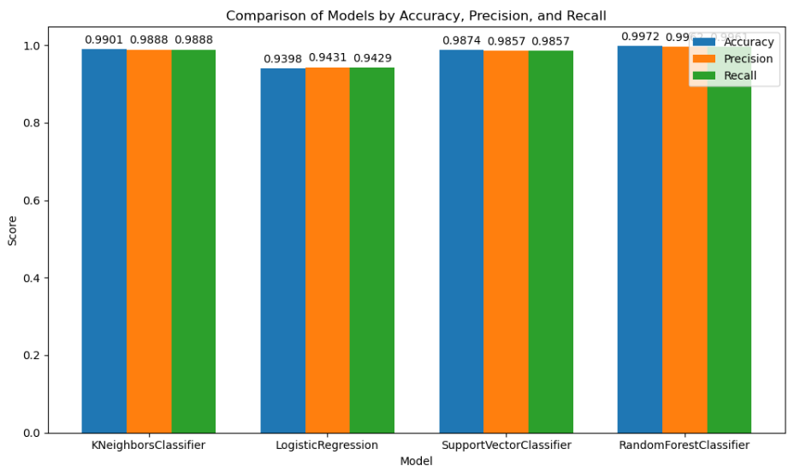
Results

Slide 8
Conclusion
All the models performed well on the test dataset giving accuracy above 0.9.
Random Forest performed best for the anomaly classification among the 4 giving best accuracy, precision and recall results.
Thus created an automated Network Intrusion Detection System capable to detect anomalies with an Accuracy of 0.99 along with Precision and Recall nearly 1.

Slide 9
Thank You

